Slide 1
General information about OwnYourSECAP project

Slide 2
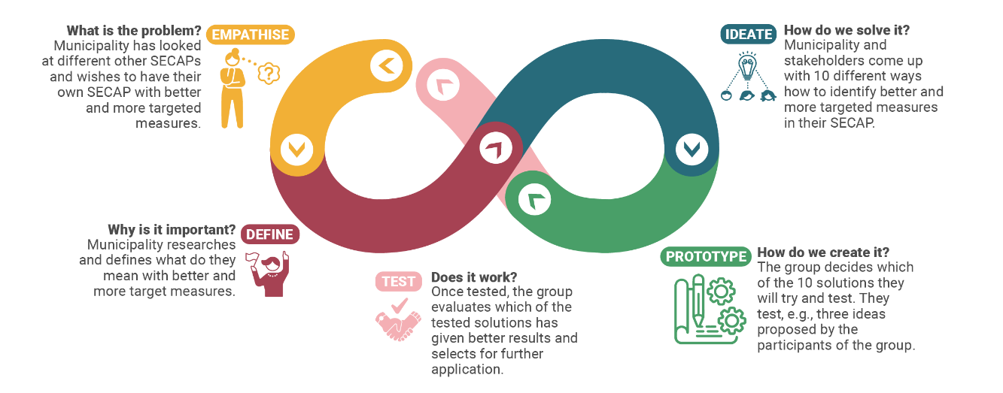
Our overall objective
Introduce systematic approach in implementation of the SECAPs
Design thinking approach
energy management systems (EnMS) concept according to ISO 50001 standard,
climate adaptation in municipalities concept according to ISO 14092, and
innovative engagement approaches.
https://www.ownyoursecap.eu/
SECAP – Sustainable Energy and Climate Action Plan

Slide 3
Three pillars
Energy management
Implementation of SECAP measures
Climate mainstreaming

Slide 4

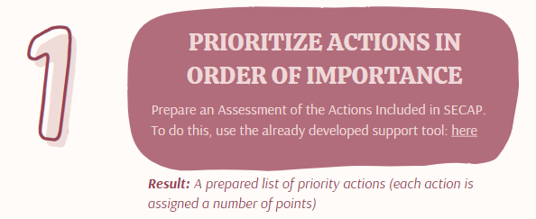
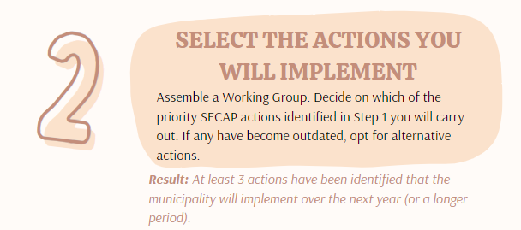
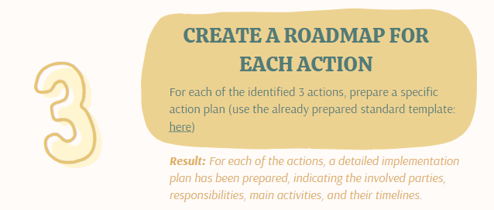
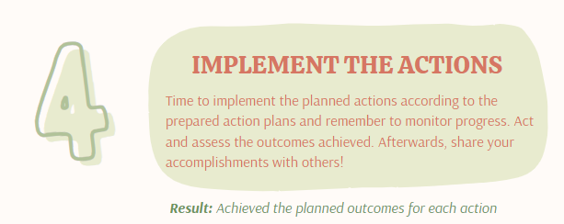
https://www.ownyoursecap.eu/resources/
Results of the first year in OwnYourSECAP:
71 measures have been implemented
212 local public officers involved
total investments around 39 million EUR
anticipated energy savings of 327 GWh in total

Slide 5
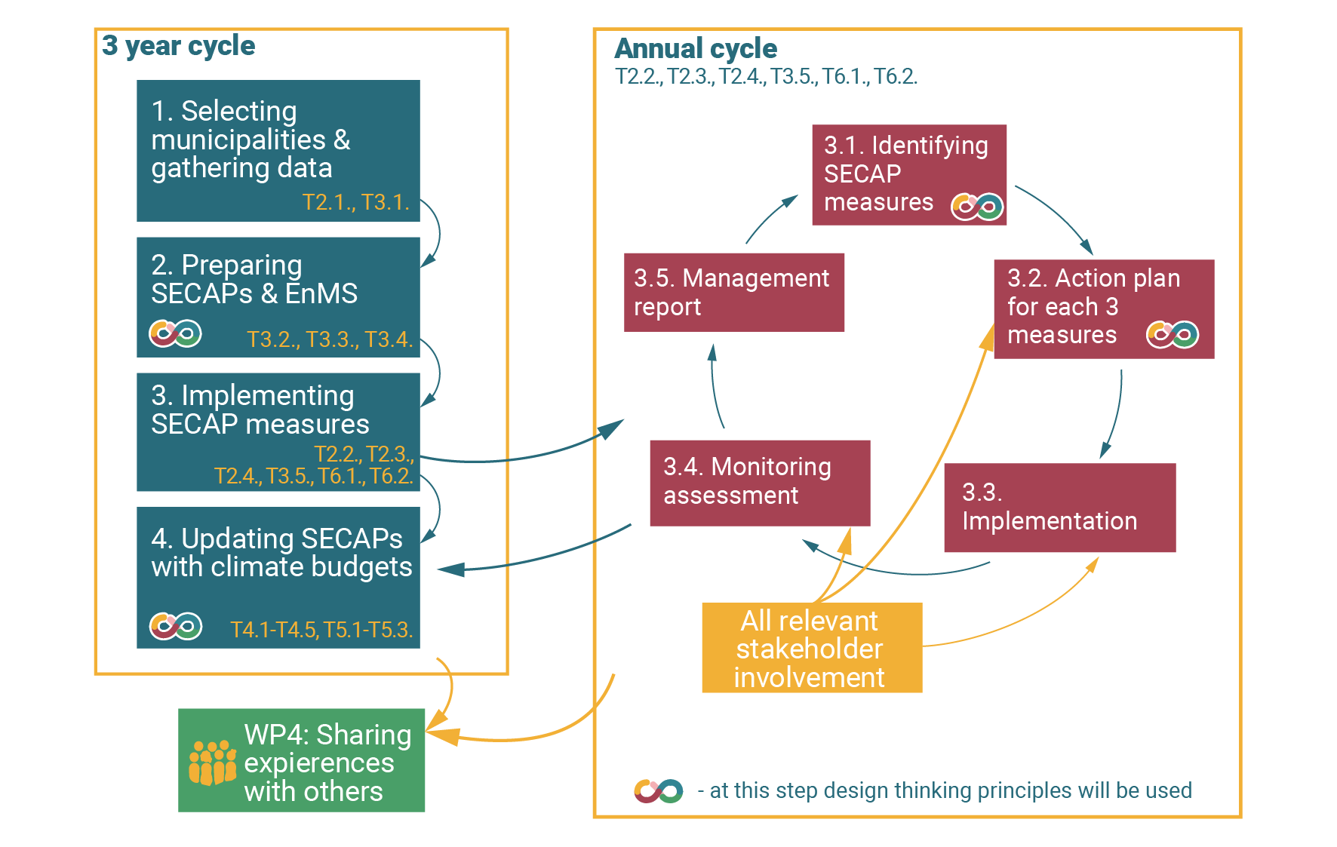
Our pathway

Slide 6
Climate mainstreaming in municipal budgets
1. Understand the proportion of the annual budget allocated to climate actions, both in Euros and as a percentage.
2. Secure political commitment to augment the yearly municipal budget dedicated to climate actions.
3. Guarantee the effective implementation of these budget allocations.
Notes:
Goal is to align public expenditure and investments with climate objectives
Reach it through integration of climate change considerations into the planning, formulation, implementation, and monitoring of municipal budget across various sectors and levels of governance

Slide 7
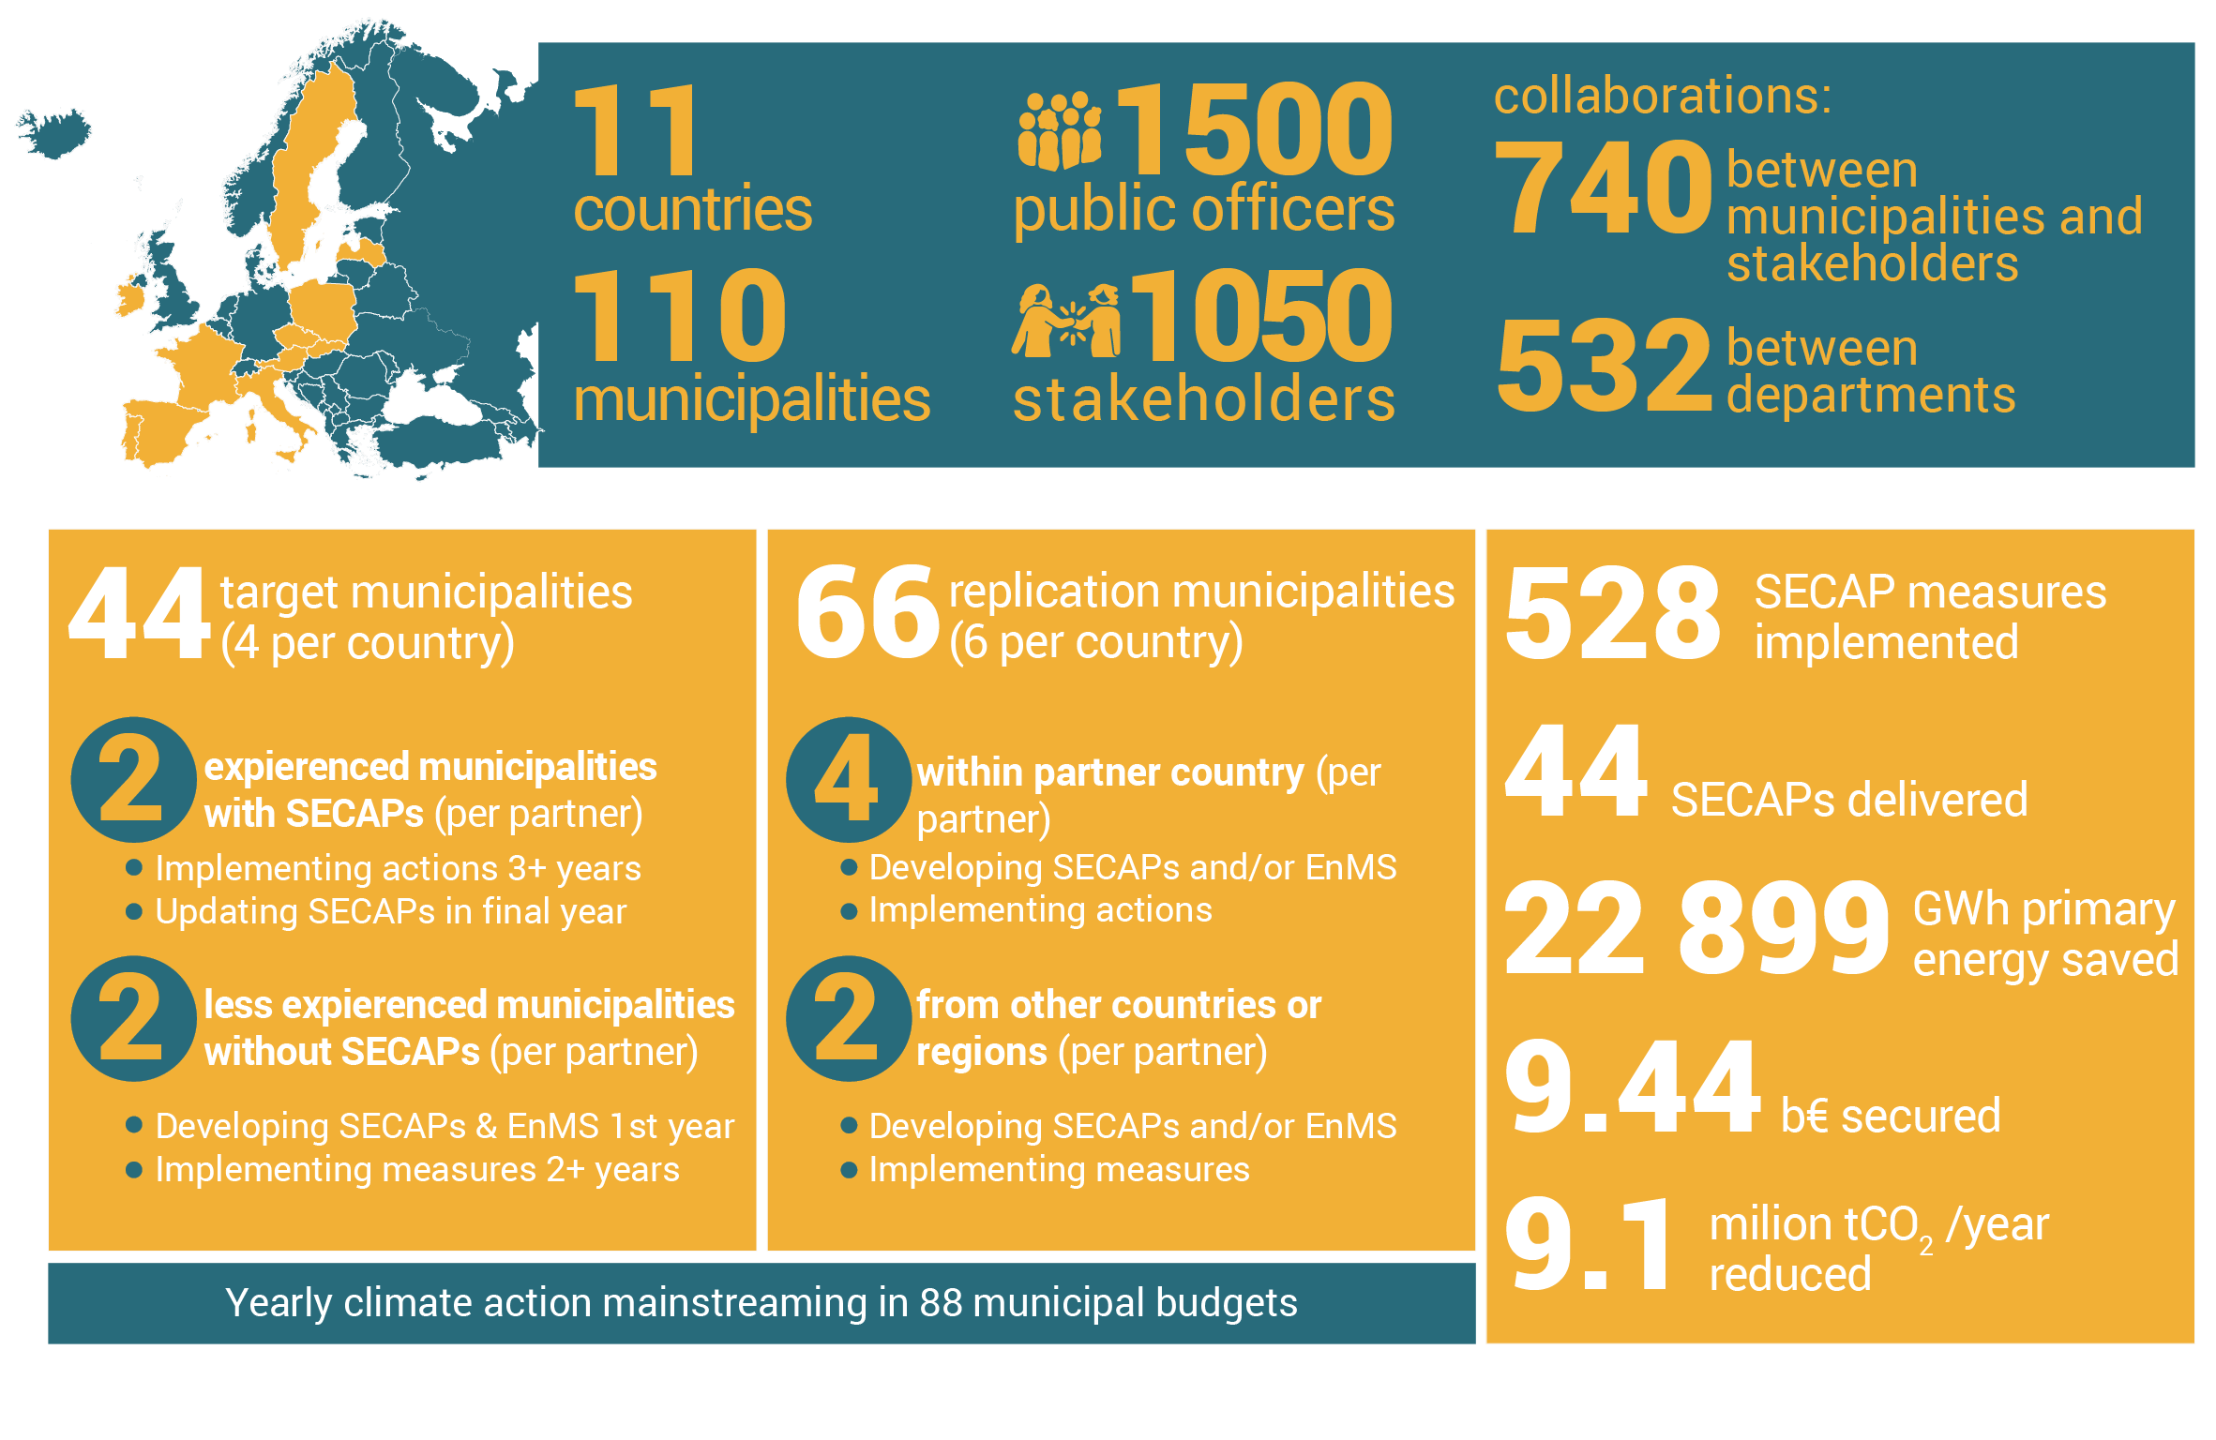
Our targets

Slide 8

Replication organisations deliver
action plans for three SECAP measures per municipality

Slide 10
Learnings from systematic Implementation of SECAPs

Slide 11
Overview on presentation
Introduction: What is a SECAP
Development of SECAPs
Learnings from the project
Final thoughts

Slide 12
Introduction
What is a SECAP (sustainable energy and climate action plan)?
Background: Covenant of Mayors
Follow-up of SEAPs
Covered areas
    climate mitigation
    climate adaptation
    energy poverty

Slide 13
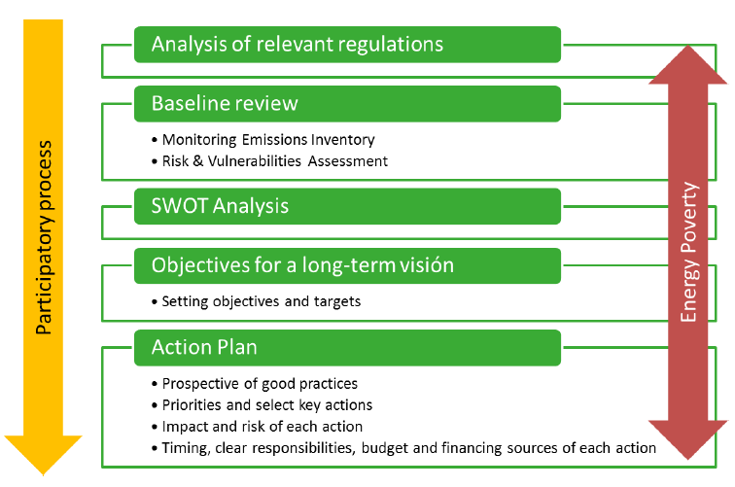
Development of SECAPs
Policy committment!
Source: EUROVERTICE 2019)

Slide 14
Elements of SECAPs
Status quo („internal audit“)
Energy consumption and GHG emissions
Vision and strategy
Action plan
    Description
    Sectors
    Responsibilities
    Resources
    Impacts
Monitoring of implementation

Slide 15
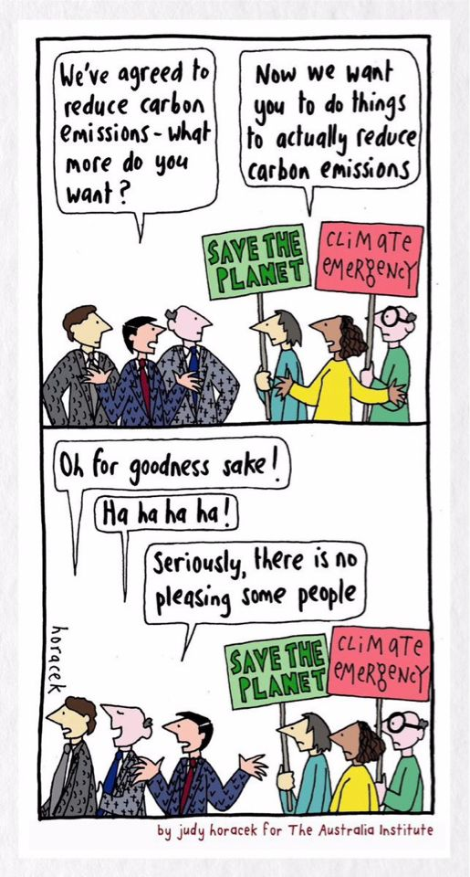
Learnings: Success factors
Political committment at all phases, not only on goals
Integration into legal and administrative structure in the municipality
Resources, resources, resources!
    Qualified staff
    Money
    Time
    Social capital and communication
Committment of citicens and stakeholders
Flexibility („Living document“)
Start!

Slide 16
Selection of measures
Select measures for all relevant sectors
Consider climate mitigation, climate adaptation and fuel poverty (interactions and synergies)
Look into your energy and GHG inventory (Results will mostly be the same ;-)
Review other SECAPs and best practice examples
Be a role model: municipality is the best sector to start!
Start where you are, but start!

Slide 17
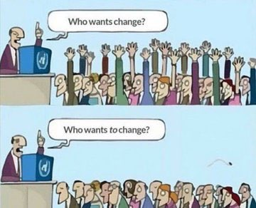
Implementation of measures
Internal communication of the SECAP
Implementation should be integrated into existing processes and structures
Tailor-made solutions, developed by the responsible administrative units
Secure necessary resources (+ external funding)
External communication of plans and implementation (success stories)
Flexibility: adapt your actions where necessary

Slide 18
Monitoring and reporting
Develop - simple to measure - indicators for implementation actions and - sometimes more difficult - impacts
Use tools for monitoring (and EnMS)
Monitor and report regularly - and adapt your plan based on the report
Communication, communication, communication!

Slide 19
Final thoughts
Do the right things (important)
Avoid the wrong things (much more important)
>> A SECAP is not an additional instrument, it should cover and integrate ALL activities of the municipality (direct control) and its citicens (indirect control)

Slide 20



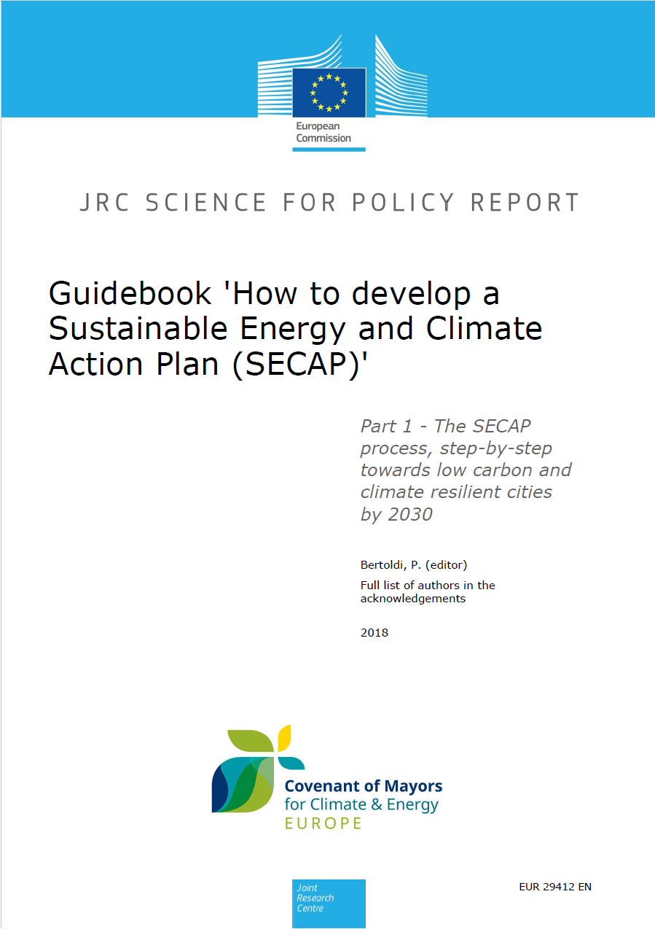
Resources

Slide 22
Examples of SECAP measures implemented

Slide 23
SECAP sectors to be tackled
Energy Efficiency Measures
  Retrofitting public buildings with energy-efficient lighting, heating, and cooling systems;
  Implementing Energy Management Systems to monitor and optimize energy usage in municipal facilities;
  Promoting energy-saving practices among residents and businesses through awareness campaigns and incentives.
  Renewable Energy Deployment
    Installing solar panels on public and private buildings;
    Promoting and establishing community-owned solar or wind projects;
    Bioenergy retrofit actions for district heating boilers and CHPs.
  Transportation and Mobility
    Expanding public transportation infrastructure and services;
    Promoting the use of electric vehicles (EVs) + EV charging infrastructures;
    Implementing bike lanes and pedestrian-friendly infrastructure.
  Waste Management and Recycling
    Implementing waste reduction and recycling programs;
    Encouraging businesses to adopt sustainable packaging practices.

Slide 24
SECAP sectors to be takled
Climate Adaptation and Resilience
  Conducting vulnerability assessments to identify areas at risk of climate-related impacts, such as flooding or heatwaves;
  Developing and implementing strategies to enhance resilience, such as green infrastructure projects to mitigate urban heat island effects or flood management measures;
  Integrating climate considerations into urban planning processes to ensure that future development is resilient to climate change.
  Community Engagement and Education
  Organizing workshops, seminars, and community events to raise awareness about climate change and the importance of sustainable practices;
  Engaging residents, businesses, and local organizations in the development and implementation of SECAP actions through stakeholder consultations and partnerships;
  Policy and Governance
  Measures aimed at strengthening policy frameworks, governance structures, and institutional capacities to support sustainable energy and climate action.
  Involve adopting climate action plans and policies, establishing regulatory frameworks to promote SECAP implementation

Slide 25
What support do municipalities need?
Technical Assistance
  Many municipalities may require technical expertise to assess their current energy and climate situation;
  Support in conducting energy audits, analyzing data, identifying appropriate technologies and solutions, and monitoring progress.
  Financial Support
  Implementing SECAP actions often requires significant financial resources;
  Municipalities may need support in accessing funding sources, such as grants, loans, and subsidies, to finance SECAP implementation.
  Capacity Building
  Building the capacity of municipal staff and stakeholders is crucial for successful SECAP implementation;
  Workshops, and knowledge-sharing activities to enhance skills and knowledge in areas such as energy management, renewable energy technologies, climate adaptation, and stakeholder engagement.
  Monitoring and Evaluation
  Establishing robust monitoring and evaluation mechanisms is critical for tracking progress, assessing the effectiveness of SECAP actions;
  Monitoring frameworks, collecting and analyzing data, and reporting on outcomes and impacts.

Slide 26
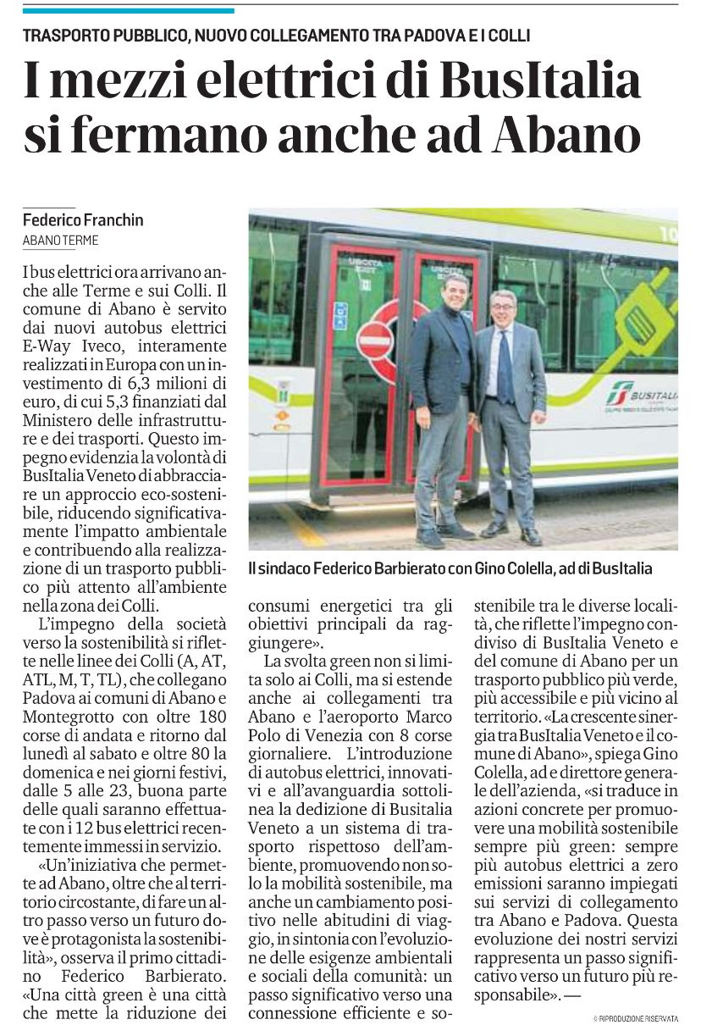
Examples of SECAP measures
Transport and Mobility – Abano Terme City (OYS City)
1. Electrification of public transport | Description: Transition from traditional fossil fuel-powered vehicles to electrically powered ones in the public transportation sector. Target: 20 new electric buses for Abano Terme City (268 trips/week) Stakeholders engaged: Bus Italy SpA Sector: Policy and governance measure Investments: 6,300,000€ Benefits: Renewal of vehicle fleet, zero emissions in the area, improvement of the quality of service 1,222 MWh saved 322 tCO₂e avoided

Slide 27
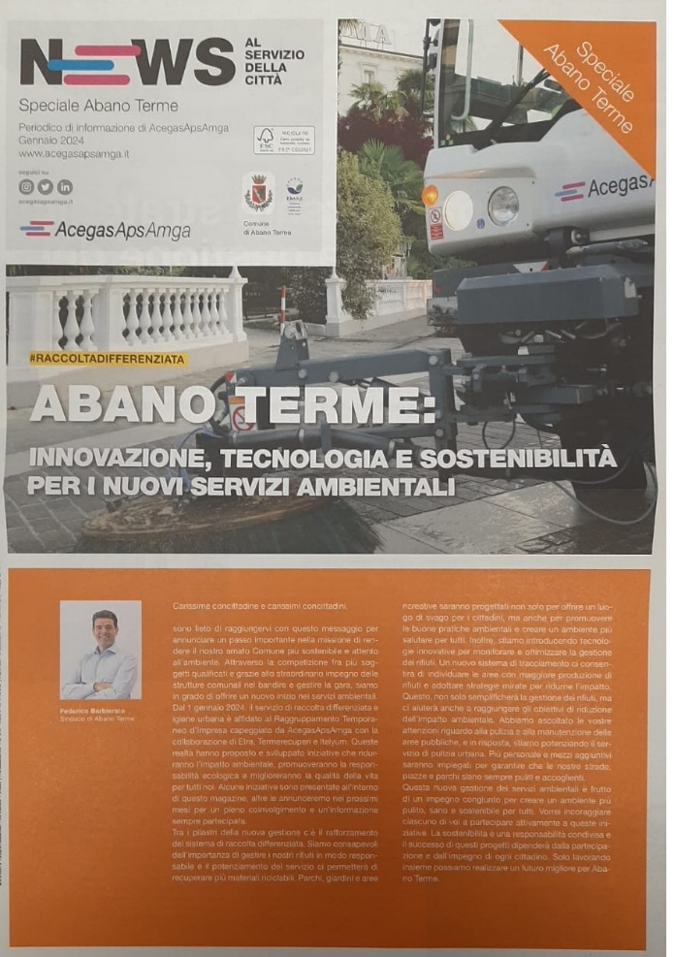
Examples of SECAP measures
Waste Management and Recycling – Abano Terme City (OYS City)
2. New services for waste collection improvement Green Hotel Project | Description: Further increase in separate waste collection and reduction in the quantity of undifferentiated waste Target: 38% reduction in undifferentiated waste - 9% increase in separate waste collection) in cooperation with City Hotel (Green Hotel project). From 75% to 84% of separated wast collection. Stakeholders engaged: Hoteliers Association (78 Hotel), AcegasAPSAmga (waste management company) Sector: Public and private partnership Investments: N.A. Benefits: Reduction of waste production; Reduction of dry waste in landfill; Reduction of emissions from waste treatment 169 tCO₂e avoided

Slide 28
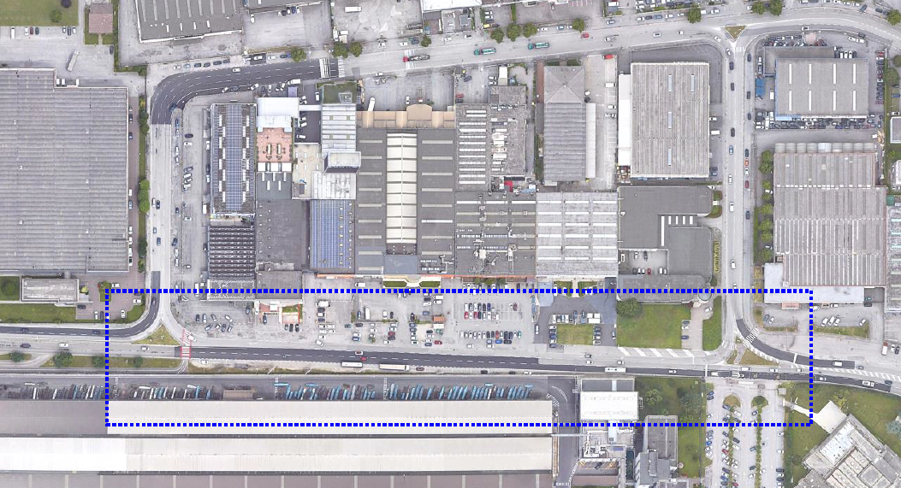
Examples of SECAP measures
Cycle routes and urban regeneration Via della Scienza – Vicenza (OYS City)
3. Cycle routes and green axes for urban regeneration of the industrial area | Description: The project aims to mitigate the effects of climate change, such as heat waves, extreme rainfall or drought, through the restoration of soil permeability and the creation of new green spaces, and the overall redevelopment of the road axis Target: New traffic configuration with 30 km/h zone area. New 1.2 km cycle/pedestrian path, new green geometry with increase in permeable and draining surfaces, mitigation of the heat island effect Stakeholders engaged: Industrial and Commercial Companies operating in the area Sector: Climate Adaptation and Resilience + Mitigation Investments: 542,000€ Benefits: Intermunicipal connection cycle path, green flowerbeds for rainwater drainage, safety of road infrastructure and pedestrian crossings 20 tCO₂e avoided

Slide 29
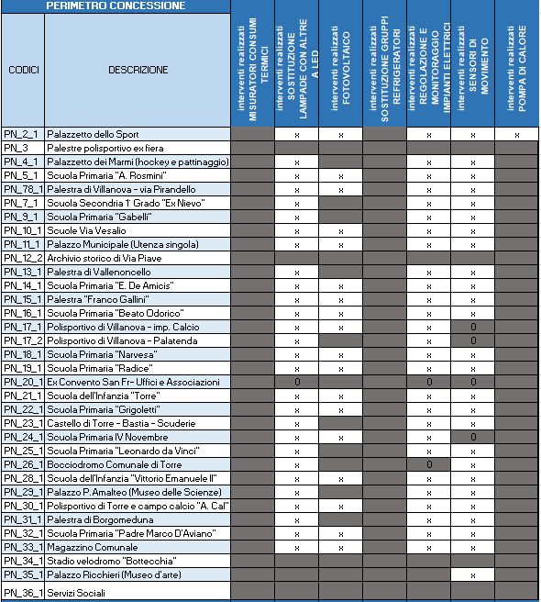
Examples of SECAP measures
Energy efficiency measures– Pordenone (OYS City)
4. Energy efficiency improvement of municipal buildings | Description: Energy efficiency improvement of municipal buildings through project financing controlled by an EnMS Target: Energy efficiency improvement of 82 municipal buildings under concession to an ESCO for the supply and management of thermal and electrical energy services and forming part of the ISO 50001 perimeter of the Municipality of Pordenone Stakeholders engaged: SIRAM SpA Sector: Public and private partnership with an ESCO Investments: 6,775,762€ Benefits: Energy efficiency improvement of municipal buildings, installation of renewable source systems, continuous monitoring via ISO 50001 certified Energy Management System 3,433 MWh saved 769 tCO₂e avoided

Slide 30
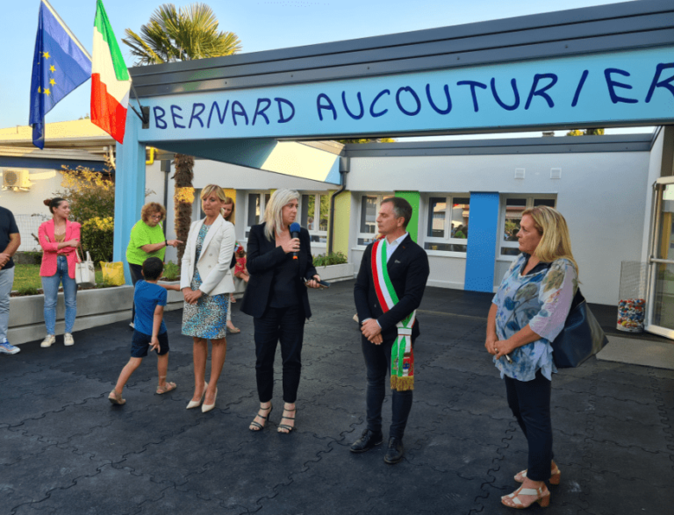
Examples of SECAP measures
Energy efficiency measures– Porcia (OYS City)
5. NZEB Bernard Aucouturier School | Description: Architectural and plant engineering works, including the installation of photovoltaic panels, aimed at making the structure energy efficient. Target: Energy efficiency improvement of the Bernard Aucouturier Primary School – From Energy Class E to NZEB Building Stakeholders engaged: Friuli Venezia Giulia Region + Citizens and Education stakeholders Sectors: Commununity engagement and education + Energy efficiency Investments: 1,500,000€ (FVG Region co-financing: 800,000€) Benefits: Energy efficiency improvement of municipal buildings, installation of renewable source systems 600 MWh saved 120 tCO₂e avoided

Slide 31
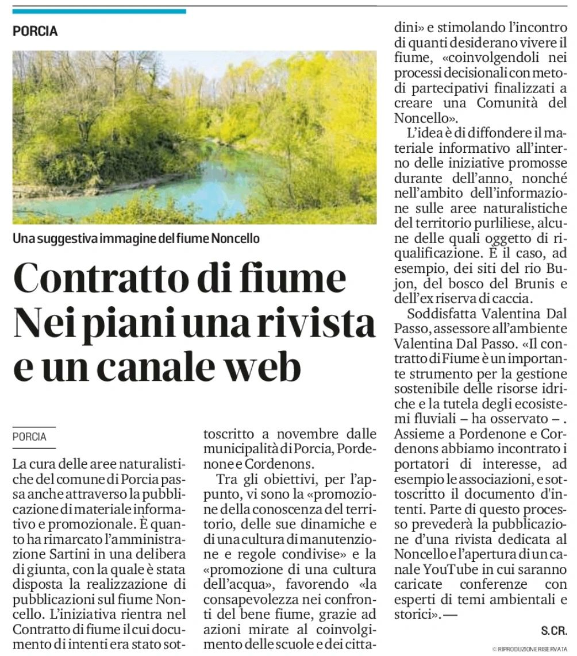
Examples of SECAP measures
Climate adaptation and resilience – Pordenone Conurbation (OYS Cities)
6. Resilience actions on the Noncello river - Pordenone Conurbation river contract | Description: Inter-municipal project for improving the condition of the river environment: from the tourism sector (slow mobility) to the environmental sector (protection and census of biodiversity of flora and fauna), from the landscape sector (historical and cultural). Target: Encourage interventions aimed at containing exotic animal and plant species, encouraging the establishment of native ones; to combat bank erosion and landslides with forestry bioengineering techniques; to collaborate on problems related to the regulation of water, the environmental natural system and the landscape. Stakeholders engaged: citizens, public and private stakeholders Sector: Climate adaptation and resilience Investments: Not yet available Benefits: Renaturalization of the river area, implementation of the Water Protection Plan, gentle mobility, enhancement of the river environment

Slide 33
Timetable for consultation for SECAP implementation

Slide 34
Timetable for implementation of the task
  On a date before summer holiday 2024
  Respective international replication organisation, in cooperation with the OwnYourSECAP-partner, organise, the first of two specific tailor-made online or physical national or regional workshops, approximately 2 hours. The purpose of the meeting is to introduce OwnYourSECAP tools and approaches for possible replication, to at least ten invited municipalities.
  Respective international replication organisation is responsible for conducting the event.
  One or two municipalities are selected as international replication municipalities by the international replication organisation.

Slide 35
Timetable for implementation of the task
  After the first of the two specific tailor-made workshops, the replication organization select two (one for some of you) replication municipalities and ensure identification and implementation of at least three SECAP measures. In order to do that, individual consultations with the municipalities will be ensured to transfer knowledge and the approach for SECAP measure implementation in the selected municipalities.

Slide 36
Timetable for implementation of the task
On a date April 2025 – May 2025
The replication organisation organise, in cooperation with respective OwnYourSECAP partner, the second of the two specific tailor-made online or physical national or regional workshops, approximately 2 hours. The purpose of the workshop is to present results and outcomes of the activities of the replication in the municipalities, to at least ten invited municipalities.
Respective international replication organisation is responsible for conducting the event.

Slide 37
Timetable for implementation of the task
June 30, 2025, by the latest:
Report to respective OwnYourSECAP beneficiary, on implementation of the three measures. A template for reporting the measures will be available.

Slide 38
Timetable in summary
 | 2024 |  |  |  |  |  |  |  | 2025
 | April | May | June | July | August | September | November | December | January | February | March | April | May | June
 | Introductory event | First workshop organised by internat. replic. organ. |  | Three one to one consultations between internat. replic. organ. and replic. municipality |  |  |  |  |  |  |  | Second workshop organised by internat. replic. organ. |  | Delivery of three measures

